Slide 1
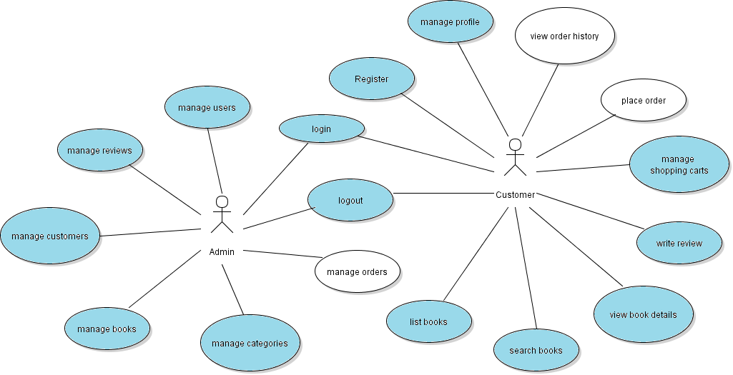
Code Order Management Module
Part 1

Slide 2
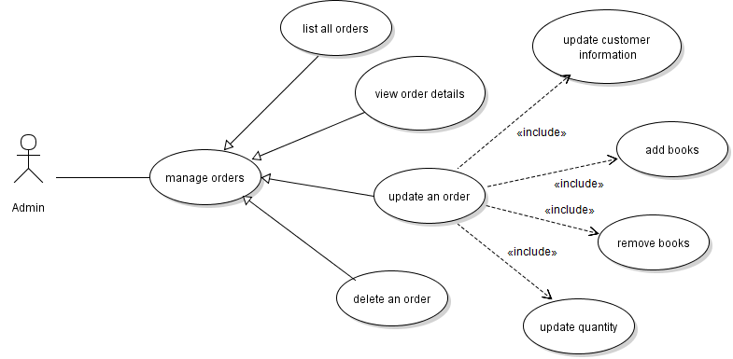
Use Case Manage Orders

Slide 3
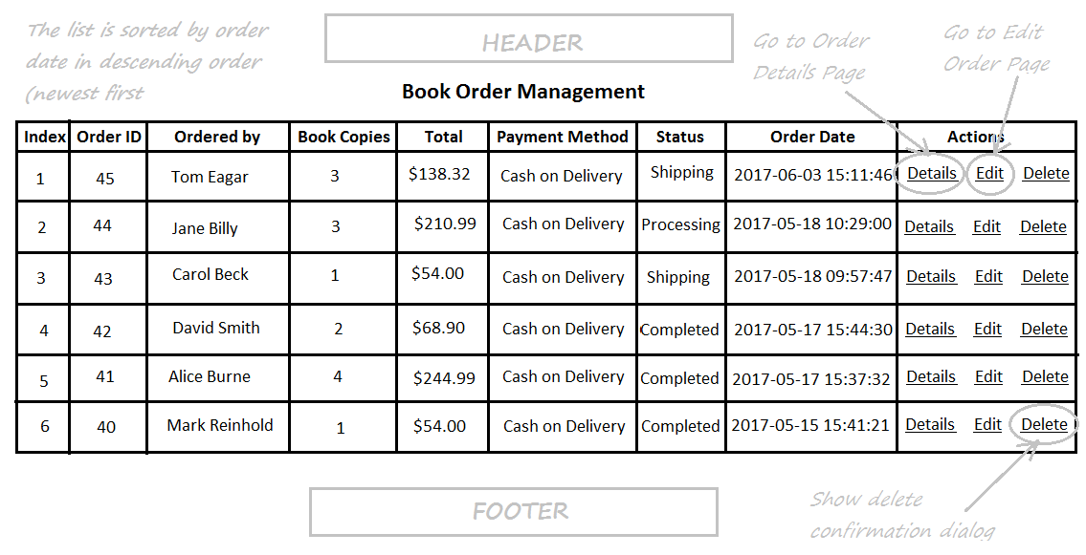
Oder List Page

Slide 4
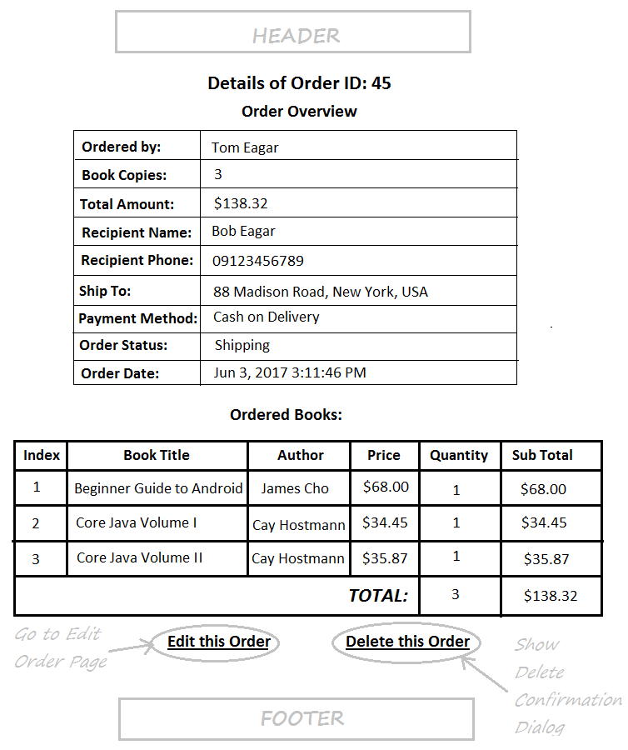
Oder Details Page

Slide 5
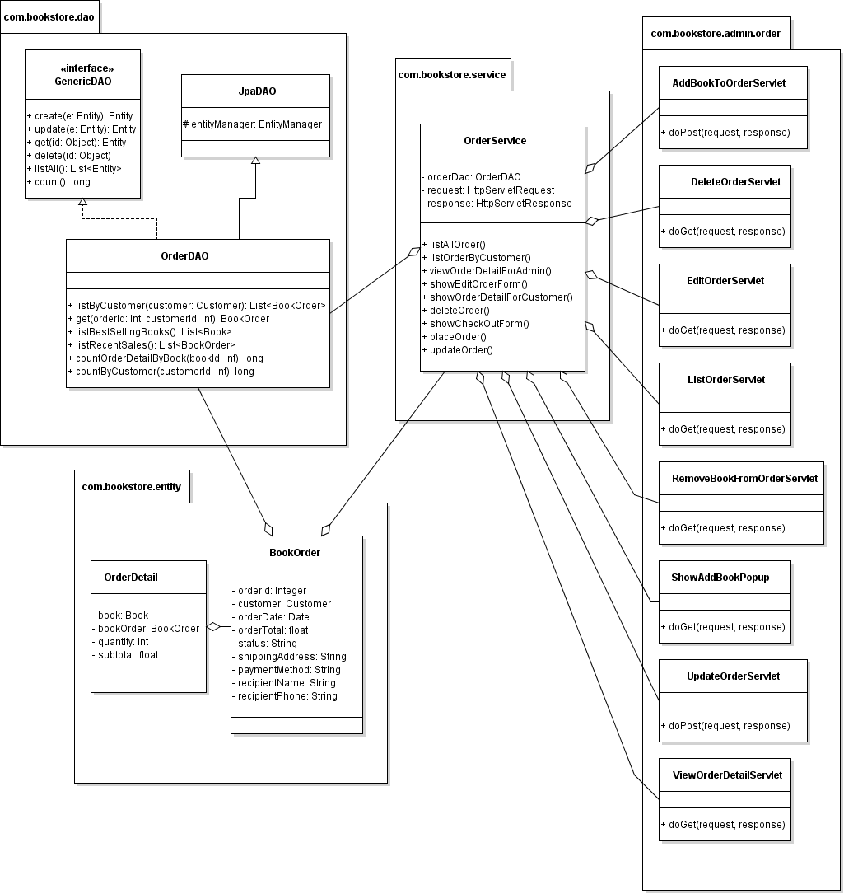
Class Diagram

Slide 6
Code Order Management (part 1)
Code OrderDAO Class + Unit Tests
Implement List Orders Feature
Implement View Order Detail Feature

Slide 7
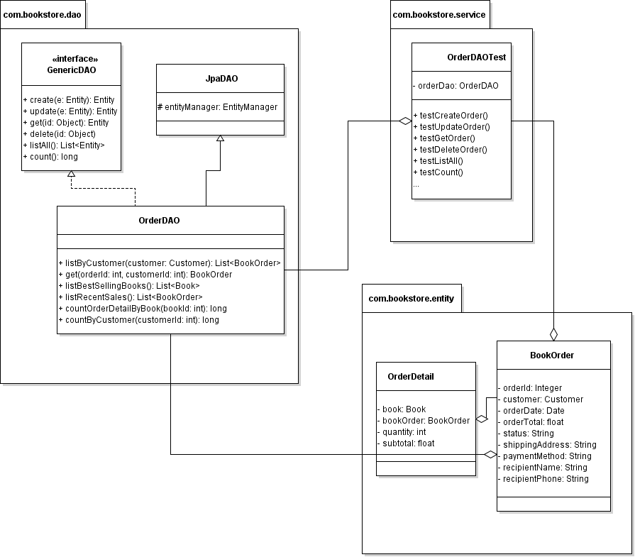
Code OrderDAO + Unit Tests

Slide 8
Implement List Orders Feature

Slide 9
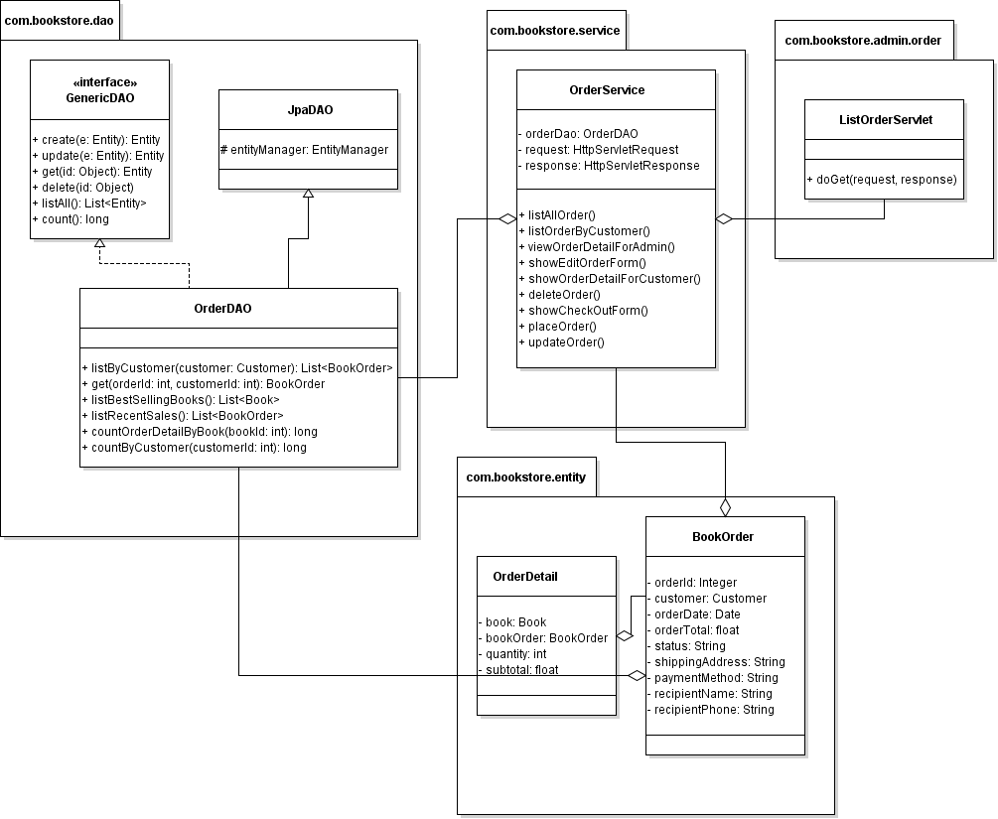
Class Diagram

Slide 10
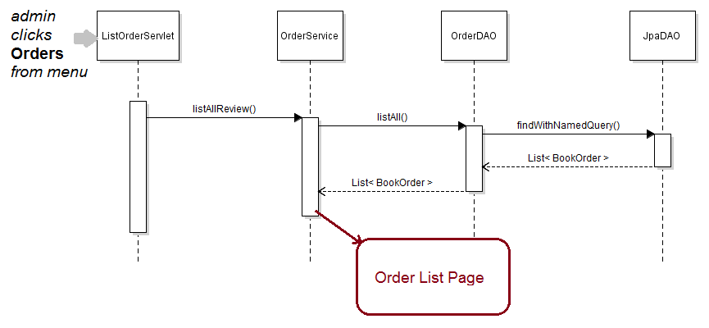
Sequence Diagram: List Orders

Slide 11
Implement View Order Detail Feature

Slide 12
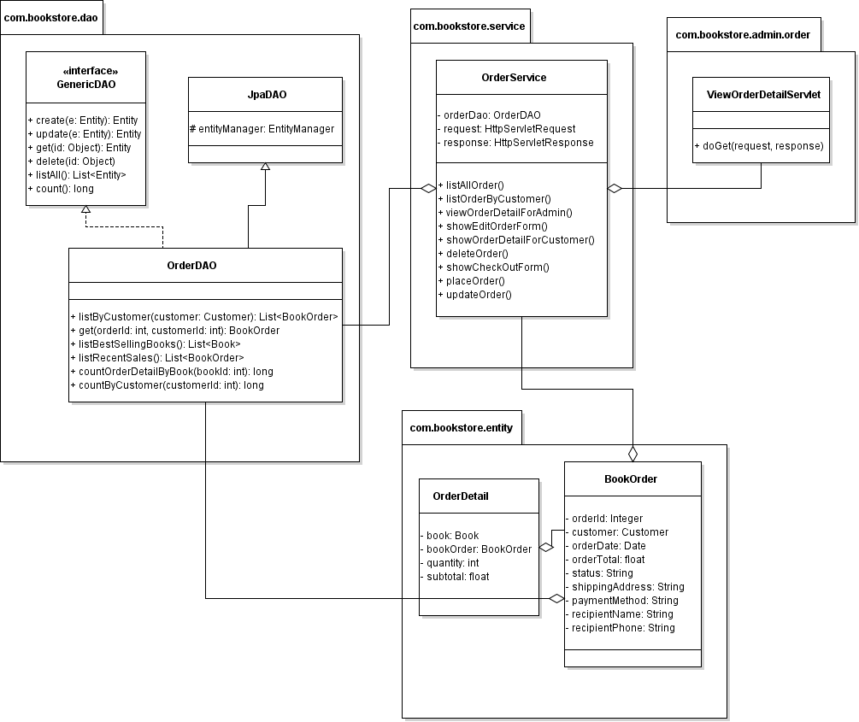
Class Diagram

Slide 13
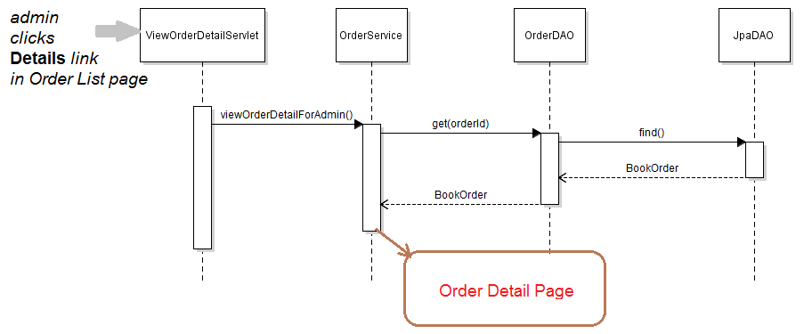
Sequence Diagram: View Order Detail

